Slide 1
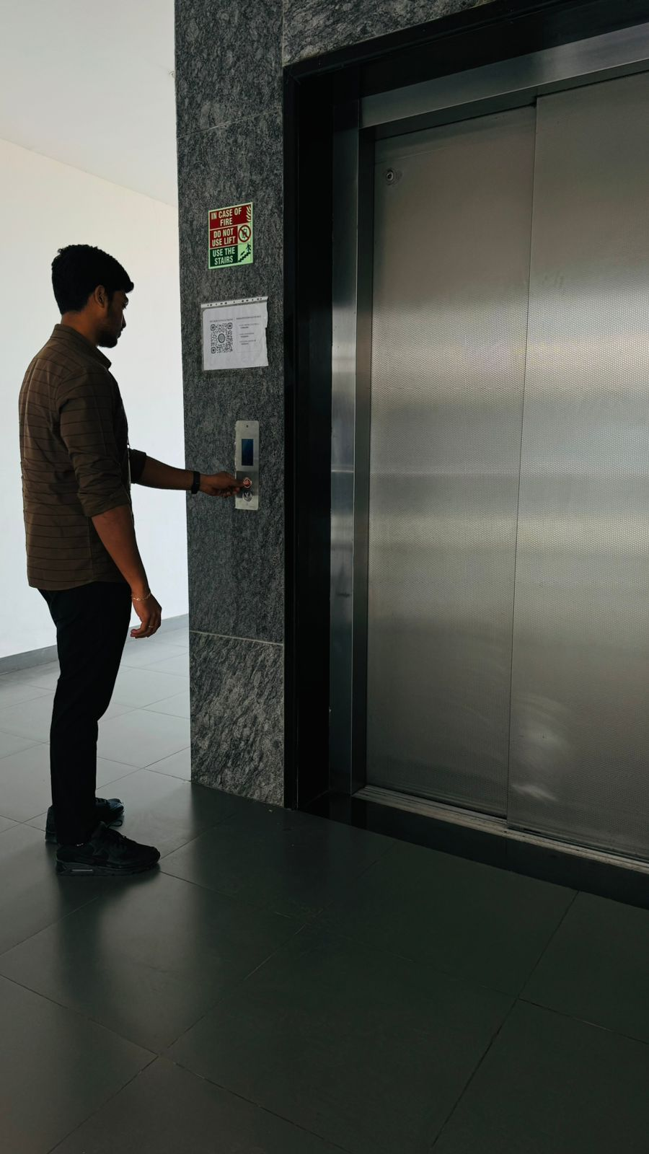

LIFT
MANAGEMENT
SYSTEM

Slide 2
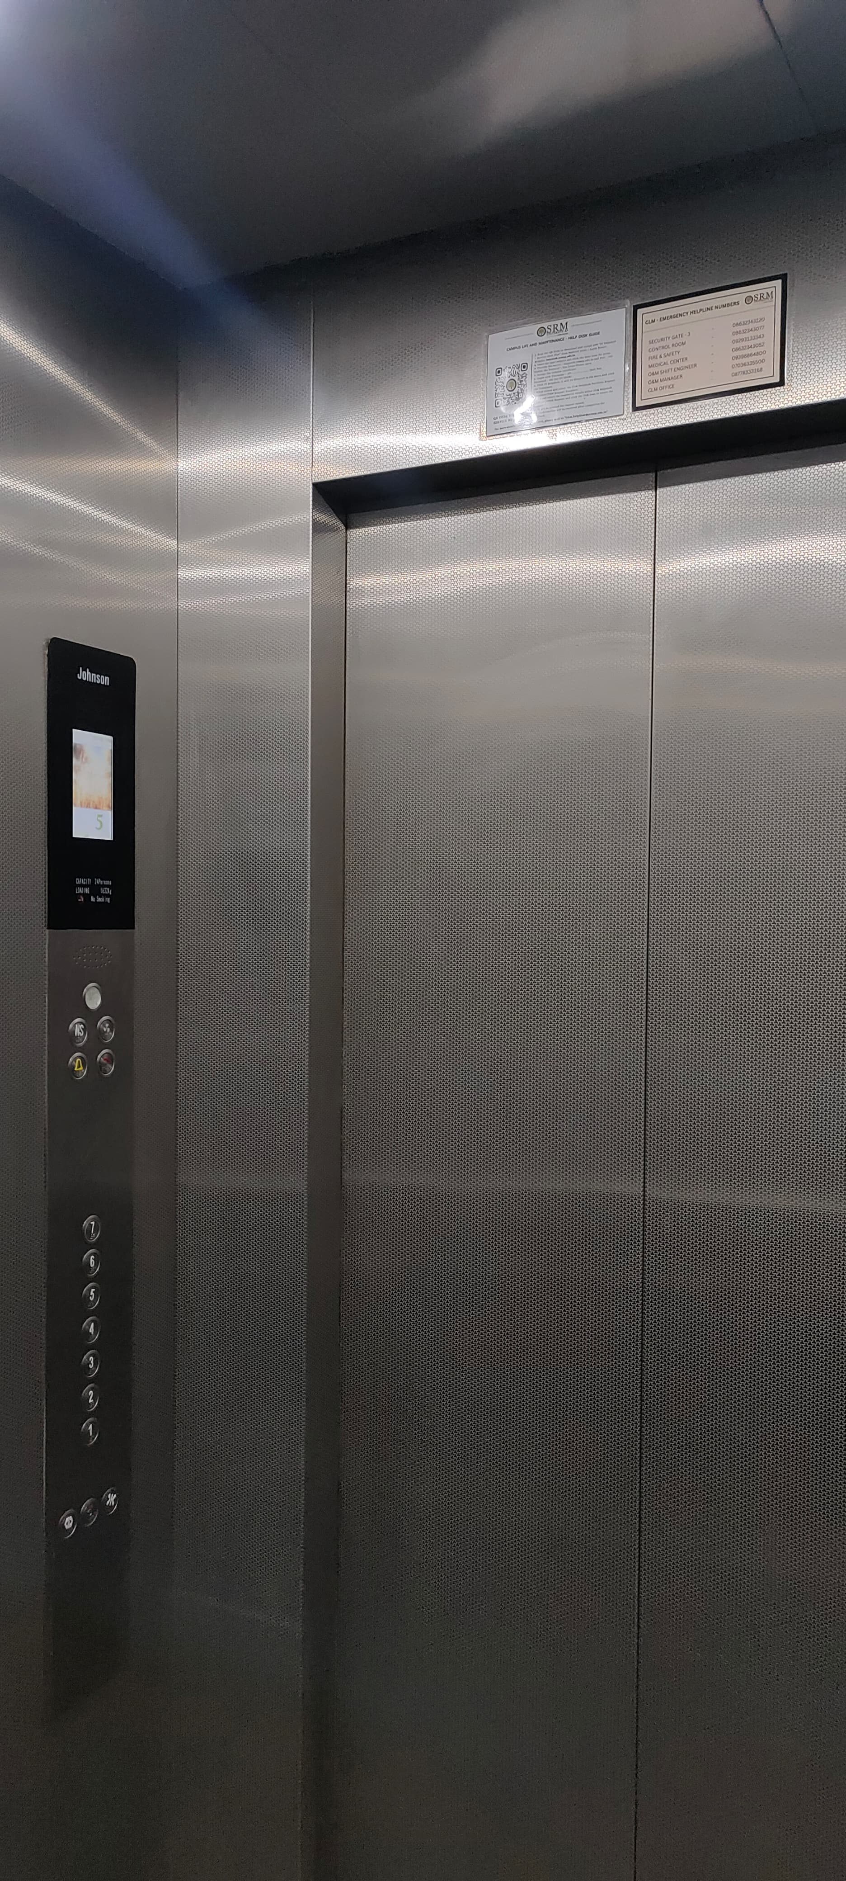

INTRODUCTION
Lift Management Systems (LMS) play a crucial role in ensuring elevators operate safely, efficiently, and reliably in buildings of all types and sizes.

Slide 3


Components of LMS
Control Panel
Sensors
The control panel manages and controls elevator operations, such as managing doors, regulating speed, and handling emergency stops.
Sensors monitor elevator position, speed, load, and other parameters, delivering real-time data to the control system.
Communication Network
The communication network ensures smooth data transfer between the control panel, sensors, and other components.

Slide 4

Key Features of LMS
1
Traffic Management
2
Safety and Security
LMS helps manage elevators by scheduling them based on how many people need them, making wait times shorter and improving efficiency.
LMS includes safety features like overload protection, emergency brakes, and fire detection to keep passengers safe.
3
Energy Efficiency
4
Remote Monitoring
LMS helps track and save energy used by lifts, cutting down waste and supporting sustainability.
LMS lets you monitor and control lifts from a distance, making it easier to maintain and fix problems early.

Slide 5
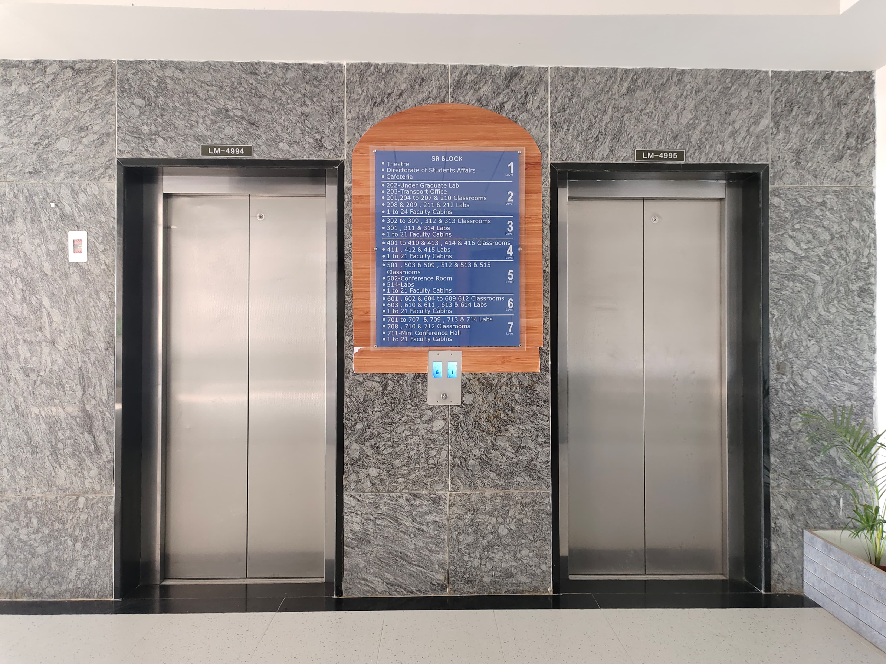
Types of Lift Management Algorithms
Destination Control Systems (DCS)
Group Control Systems (GCS)
Adaptive Algorithms
GCS systems use multiple lifts together to serve passengers better, especially in busy areas.
Adaptive algorithms change how lifts work based on things like passenger numbers, traffic, and building needs.
DCS systems let people pick their floor ahead of time, making lifts faster and reducing wait times.

Slide 6





LMS Use Cases
Commercial Buildings :
Healthcare Facilities :
LMS improves efficiency and safety in office buildings, hotels, and other commercial properties.
LMS ensures timely patient transportation and optimizes lift utilization in hospitals and clinics.
Industrial Complexes :
Residential Buildings :
LMS manages material handling and personnel transportation in factories and manufacturing plants.
LMS enhances convenience and safety for residents in multi-story apartments and condominiums.

Slide 7

Challenges in LMS Implementation
1
Integration
Connecting LMS with a building’s systems and setup can be difficult.
2
Maintenance
Regular maintenance and updates are important to keep LMS running smoothly and reliably.
3
Cost
Setting up a full LMS can be expensive at first and also costs money to maintain over time.

Slide 8


Future Trends in LMS
1
Artificial Intelligence (AI)
2
Internet of Things (IoT)
AI-powered LMS can make lifts work better using real-time data and predict what will be needed later.
IoT integration lets lifts and building systems talk to each other easily, making them safer and more efficient.
3
Cloud Computing
Cloud-based LMS platforms let you learn from anywhere, grow easily, and track progress.

Slide 9
Code:
Explanation:
The code defines a class `Elevator` with three private attributes:
- `currentFloor` (integer): Tracks the current floor of the elevator.
- `powerOn` (boolean): Indicates whether the elevator's power is on.
`fireEmergency` (boolean): Indicates if there is a fire emergency.
These attributes are encapsulated and cannot be accessed directly from outside the class. The class currently only defines these attributes without any methods to interact with them.
#include <iostream>
# include <string>
using namespace std;
class Elevator {
private:
int currentFloor;
bool powerOn
bool fireEmergency;

Slide 10
public:
Elevator() : currentFloor(0), powerOn(false), fireEmergency(false) {}
void setPower(bool state) {
if (fireEmergency) {
cout << "Cannot turn on power. Fire emergency is active!" << endl;
} else {
powerOn = state;
if (!powerOn) {
cout << "Power is off. Elevator is moving to the nearest floor..." << endl;
moveToNearestFloor();
} else {
cout << "Power is on. Elevator is ready to be used." << endl;
}
}
}
The code adds public methods to the `Elevator` class:
1. Constructor (`Elevator()`): Initializes the elevator with default values: `currentFloor` set to 0, `powerOn` set to `false`, and `fireEmergency` set to `false`.
2. setPower(bool state):
- If there's a fire emergency, it prevents turning on the power and prints an error message.
- If there's no emergency, it sets the `powerOn` state. If the power is turned off, it moves the elevator to the nearest floor by calling `moveToNearestFloor()`. If the power is on, it prints a confirmation message.

Slide 11
void setFireEmergency(bool state) {
fireEmergency = state;
if (fireEmergency) {
cout << "Fire emergency! Elevator is moving to the ground floor and opening doors..." << endl;
moveToGroundFloor();
powerOn = false;
} else {
cout << "Fire emergency cleared. Please turn on the power to use the elevator." << endl;
}
}
void moveToNearestFloor() {
if (powerOn) {
cout << "Elevator is at floor " << currentFloor << endl;
} else {
while (currentFloor > 0) {
currentFloor--;
cout << "Moving to floor " << currentFloor << endl;
}
cout << "Doors opening..." << endl;
}
}
1. setFireEmergency(bool state):
- If there’s a fire emergency, the elevator moves to the ground floor, opens its doors, and turns off the power.
- If the fire is cleared, it says to turn the power back on.
2. moveToNearestFloor():
- If the power is on, it shows the current floor.
- If the power is off, the elevator moves down floor by floor to the ground, then opens the doors.

Slide 12
void moveToGroundFloor() {
while (currentFloor > 0) {
currentFloor--;
cout << "Moving to floor " << currentFloor << endl;
}
cout << "Doors opening..." << endl;
}
void pressButtonOutside(string direction, int targetFloor) {
if (!powerOn) {
cout << "Elevator cannot be used. Power is off." << endl;
return;
}
if (fireEmergency) {
cout << "Elevator is in fire emergency mode." << endl;
return;
}
if (targetFloor < 0 || targetFloor > 15) {
cout << "Invalid floor. Please choose a floor between 0 and 15." << endl;
return;
}
This part of the code explains two functions:
1. moveToGroundFloor():
- The elevator moves down one floor at a time until it reaches the ground floor (floor 0).
- It shows a message for each floor it passes and opens the doors when it reaches the ground floor.
2. pressButtonOutside(string direction, int targetFloor):
- Checks if the power is off.
- If the power is off, it shows a message saying the elevator can't be used and stops.

Slide 13
if (targetFloor == currentFloor) {
cout << "You are already at floor " << targetFloor << ". Doors opening..." << endl;
return;
}
if (direction == "up") {
if (currentFloor == 15) {
cout << "Elevator is at the top floor (15). Cannot move up." << endl;
return;
} else if (currentFloor < targetFloor) {
moveUp(targetFloor);
} else {
cout << "Elevator is moving down. Please press the down button." << endl;
}
} else if (direction == "down") {
if (currentFloor == 0) {
cout << "Elevator is at the ground floor (0). Cannot move down." << endl;
return;
This code controls the elevator when a button is pressed:
1. Fire Emergency:
- If there's a fire emergency, it stops and shows a message.
2. Floor Check:
- If the target floor isn’t between 0 and 15, it shows an error.
- If you're already on the target floor, it opens the doors.
3. Moving Up:
- If "up" is pressed:
- It won’t go up from the top floor.
- Moves up if the target floor is above.
- Suggests pressing "down" if the target is below.

Slide 14
} else if (currentFloor > targetFloor) {
moveDown(targetFloor);
} else {
cout << "Elevator is moving up. Please press the up button." << endl;
}
} else {
cout << "Invalid button press. Use 'up' or 'down'." << endl;
}
}
void moveUp(int targetFloor) {
while (currentFloor < targetFloor) {
currentFloor++;
cout << "Moving up to floor " << currentFloor << endl;
}
cout << "Reached floor " << currentFloor << ". Doors opening..." << endl;
}
4. Moving Down:
- If "down" is pressed:
- It won’t go down from the ground floor.
- Moves down if the target floor is below.
- Suggests pressing "up" if the target is above.
5. Invalid Input:
- Shows an error if the button isn't "up" or "down."
The `moveUp(int targetFloor)` function:
1. The elevator goes up one floor at a time.
2. It shows each floor as it moves.
3. When it reaches the target, it opens the doors.

Slide 15
void moveDown(int targetFloor) {
while (currentFloor > targetFloor) {
currentFloor--;
cout << "Moving down to floor " << currentFloor << endl;
}
cout << "Reached floor " << currentFloor << ". Doors opening..." << endl;
}
bool isPowerOn() const {
return powerOn;
}
bool isFireEmergency() const {
return fireEmergency;
}
int getCurrentFloor() {
return currentFloor;
}
};
int main() {
Elevator elevator;
int option, targetFloor;
string direction;
Here’s the simplest explanation:
1. moveDown(int targetFloor):
- The elevator moves down to the target floor and opens the doors.
2. isPowerOn():
- Checks if the elevator is on.
3. isFireEmergency():
- Checks if there’s a fire emergency.
4. getCurrentFloor():
- Tells the current floor of the elevator.

Slide 16
while (true) {
if (elevator.isFireEmergency()) {
cout << "\nFire emergency active! Only options to turn off fire emergency or exit are available.\n";
cout << "1. Turn off fire emergency\n2. Exit\n";
} else if (elevator.isPowerOn()) {
cout << "\n1. Turn power off\n2. Trigger fire emergency\n3. Press outside button\n4. Exit\n";
} else {
cout << "\n1. Turn power on\n2. Turn on fire emergency\n3. Exit\n";
}
cin >> option;
if (elevator.isFireEmergency()) {
emergency is active
if (option == 1) {
elevator.setFireEmergency(false);
} else if (option == 2) {
cout << "Exiting..." << endl;
return 0;
} else {
cout << "Invalid option. Fire emergency is active!" << endl;
}
} else if (!elevator.isPowerOn()) {
if (option == 1) {
elevator.setPower(true);
} else if (option == 2) {
elevator.setFireEmergency(true);
Here’s the simplest explanation:
1. The program keeps asking for choices based on the elevator's status.
2. If there’s a fire emergency, you can either turn it off or exit.

Slide 17
} else if (option == 3) {
cout << "Exiting..." << endl;
return 0;
} else {
cout << "Power is off. No other options are available." << endl;
}
} else {
switch (option) {
case 1:
elevator.setPower(false);
break;
case 2:
elevator.setFireEmergency(true);
break;
case 3:
if (elevator.getCurrentFloor() == 0) {
cout << "Elevator is at ground floor." << endl;
} else if (elevator.getCurrentFloor() == 15) {
cout << "Elevator is at top floor." << endl;
} else {
cout << "Elevator is at floor " << elevator.getCurrentFloor() << "." << endl;
}
if (elevator.getCurrentFloor() == 15) {
cout << "Elevator is at the top floor. Can only move down." << endl;
direction = "down";
}
3. If the power is on, you can:
- Turn it off,
- Trigger a fire emergency,
- Use the elevator,
- Or exit.
4. If the power is off, you can:
- Turn it on,
- Trigger a fire emergency,
- Or exit.
5. The program does what you choose, or tells you if it's not allowed.
1. Option 1 (Turn Power Off):
- Turns off the elevator.
2. Option 2 (Activate Fire Emergency):
- Turns on fire emergency mode.
3. Option 3 (Check Floor and Move):
- Tells you where the elevator is:
- At the ground floor, it can only go up.
- At the top floor, it can only go down.
- On any other floor, you can choose up or down.
- Then, it asks which floor to go to and moves there.

Slide 18
else if (elevator.getCurrentFloor() == 0) {
cout << "Elevator is at the ground floor. Can only move up." << endl;
direction = "up";
} else {
cout << "Press 'up' or 'down': ";
cin >> direction;
}
cout << "Which floor would you like to go to? (0-15): ";
cin >> targetFloor;
elevator.pressButtonOutside(direction, targetFloor);
break;
case 4:
cout << "Exiting..." << endl;
return 0;
default:
cout << "Invalid option. Try again." << endl;
}
}
}
return 0;
}
4. Option 4 (Exit):
- Stops the program.
5. Invalid Option:
- If you pick something wrong, it asks you to try again.
The program keeps going until you exit.

Slide 19


